Slide 1


Mental link in the making:
Can strong reputation compensate for intrinsic weakness?
Virginia Melgar
Chairperson of the Fifth Board of Appeal

Slide 2
Definition of the link
A mental association (not necessarily immediate) established by the relevant public between the earlier reputed mark and the contested mark.
  14/09/1999, C-375/97, Chevy, EU:C:1999:408, § 23
  23/10/2003, C-408/01, Adidas, EU:C:2003:582, § 29
  27/11/2008, C-252/07, Intel, EU:C:2008:655, § 17

Slide 3
The ‘Intel’ factors to establish the link
  The degree of similarity between the marks.
  The proximity of the goods and services and the relevant public.
  The strength of the earlier trade mark’s reputation.
  The degree of the earlier trade mark’s distinctive character.
  The existence of likelihood of confusion.
Global assessment

Slide 4
The impact of the distinctive character
The ECJ indicates that the relevant factors include the degree of the earlier mark’s distinctive character, whether inherent or acquired through use.
27/11/2008, C-252/07, Intel, EU:C:2008:655, § 42
and 13/5//2026, T-24/25 , Obelix vs Obelix § 31, EU:T:2026:343
no uniform understanding in the case-law (see Boards of Appeal’s Case-law Research Report on ‘The link between the trade marks (Article 8(5) EUTMR)’, July 2024, Conclusion (ix)
Notes:
Finally, it is clear from the case-law that the existence of such a link must be appreciated globally, taking into account all factors relevant to the circumstances of the case. Those factors include, first, the degree of similarity between the marks at issue, secondly, the strength of the earlier mark’s reputation, thirdly, the nature of the goods or services for which the marks at issue are registered, including the degree of closeness or dissimilarity between those goods or services, and the relevant section of the public, fourthly, the degree of the earlier mark’s distinctive character, whether inherent or acquired through use, and, fifthly, the existence of a likelihood of confusion on the part of the public

Slide 5
The impact of the distinctive character: two strings of case-law
Inherent distinctiveness irrelevant | Inherent distinctiveness relevant
Where reputation is established, it is irrelevant to determine the inherent distinctiveness of the earlier mark: the earlier mark has distinctive character because of its reputation 01/03/2018, T‑629/16, DEVICE OF TWO PARALLEL STRIPES / DEVICE OF THREE PARALLEL STRIPES et al., EU:T:2018:108, § 135 06/07/2022, T‑288/21, ALOve (fig.) / LOVE (fig.), EU:T:2022:420, § 69 08/09/2025, R 0018/2022‑5, AESKUCARE / AESCULAP et al. | The inherent distinctive character is an independent factor from the strength of reputation: impact on the overall assessment of the link 31/05/2017, T‑637/15, SOTTO IL SOLE ITALIANO Sotto il Sole (fig.) / VIÑA SOL et al., EU:T:2017:371, § 63; § 78 31/01/2019, T-215/17, PEAR (fig.) / APPLE BITE (fig.) et al., EU:T:2019:45, § 60 14/01/2026, R 367/2025-1, ABAN / ABANCA
Notes:
Disregarding the factor of inherent distinctiveness of the earlier trade mark and focusing solely on reputation could result in an overprotection of inherently weak marks.
Inherently weak marks should not be regarded as highly distinctive, simply because of their reputation.
Also, the weakness of the element in common between the signs may be relevant in the link assessment, as it is in the global assessment of the likelihood of confusion.
Boards of Appeal’s Case-law Research Report on ‘The link between the trade marks (Article 8(5) EUTMR)’, July 2024

Slide 6
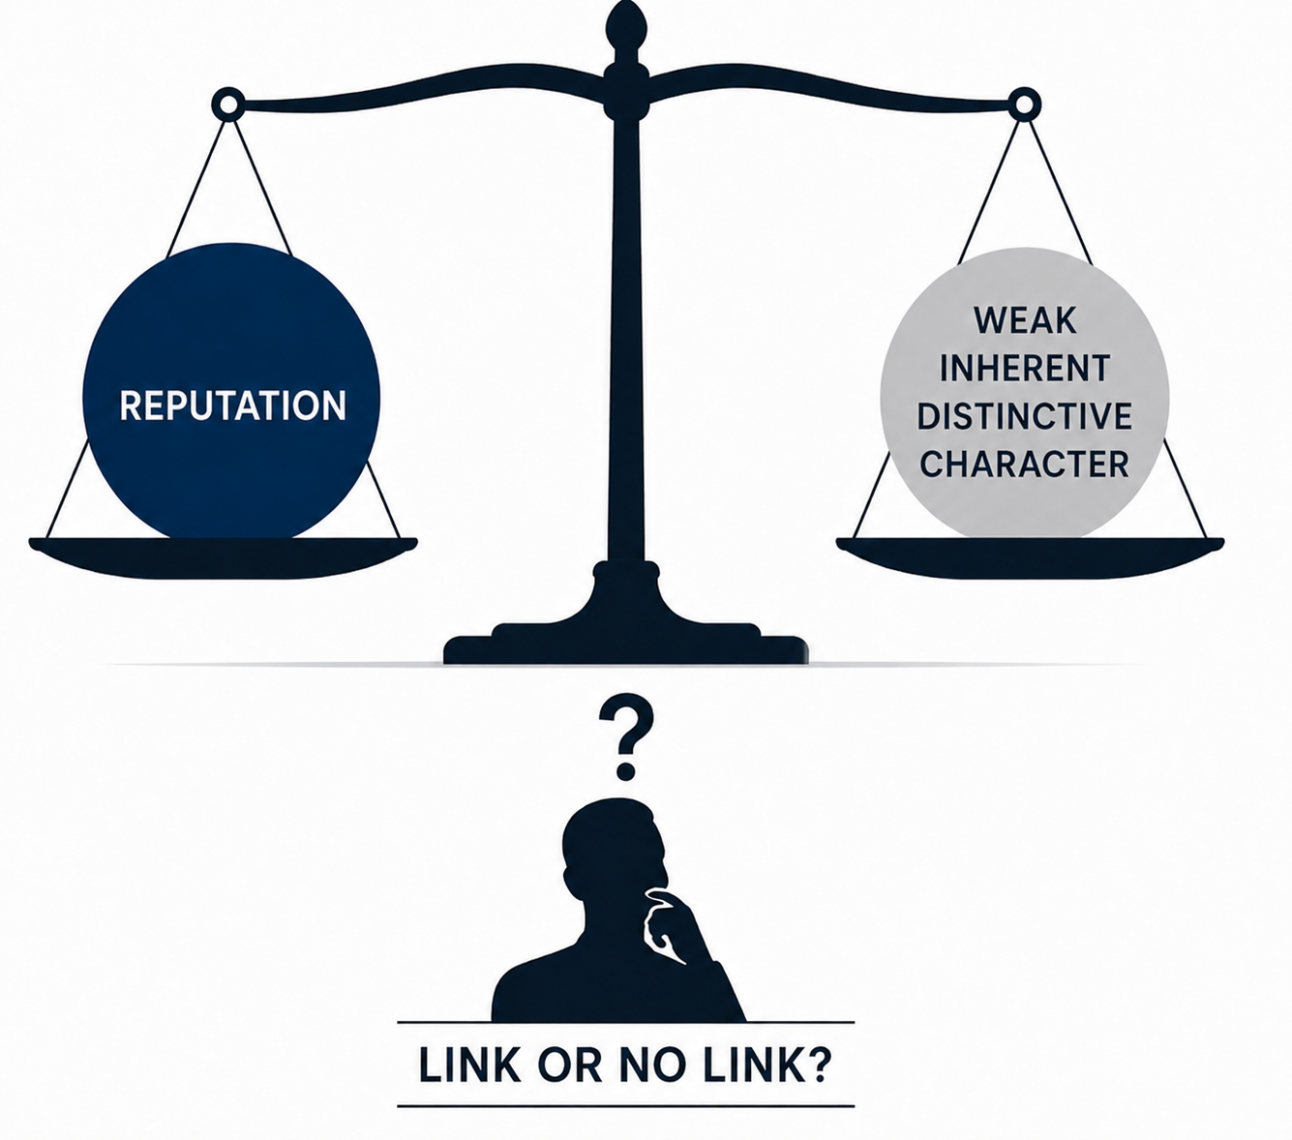
The impact of weakness when the reputation is not high: case-law

Slide 7




Case-law of the General Court
No strong reputation
No link
31/05/2017, T-637/15 | VIÑA SOL
26/09/2014, T‑490/12 | GRAZIA | GRAZIA
25/02/2016, T‑402/14 | AQUALIA /
 | Earlier signs | Contested signs

Slide 8




Case-law of the Boards of Appeal
09/07/2025, R 459/2025-2 |  | TP
09/12/2025, R 2306/2024-5 | BEBE
 | Earlier signs | Contested signs

Slide 9
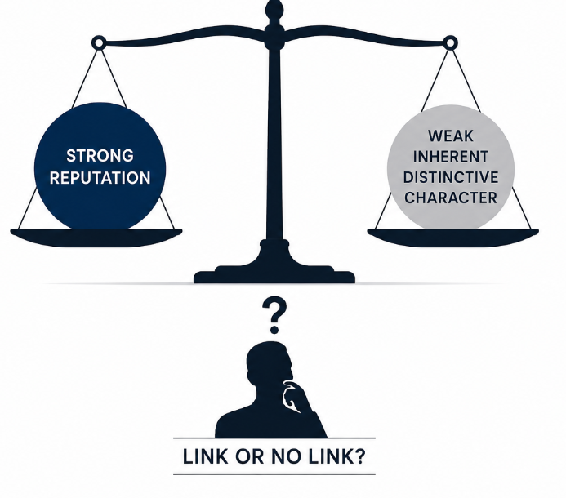
The impact of weakness when the reputation is high: Case-law from the Court

Slide 10
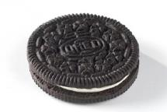
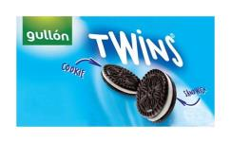

Judgments of the General Court
28/05/2020, T‑677/18, GULLÓN TWINS COOKIE SANDWICH (fig.) / OREO et al., EU:T:2020:229 weak earlier mark
Exceptional reputation
Link
Earlier sign | Contested sign

Slide 11

Judgments of the General Court
12/06/2024, T-604/22, TOUR DE X (fig.) / TOUR DE FRANCE et al., EU:T:2024:377 weak common element
Exceptionally high
No link
TOUR DE FRANCE
Earlier sign | Contested sign

Slide 12


Judgments of the General Court
07/06/2023, T‑541/22, Sanity Group (fig.) / SANYTOL (fig.) et al., EU:T:2023:310 weak common element
Substantial reputation
Link
Earlier sign | Contested sign

Slide 13
The impact of weakness when the reputation is high: Case-law of the Boards of Appeal

Slide 14


Case-law of the Boards of Appeal
27/03/2026, R 102/2024-1, FCI RACING PIGEONS OLIMPIAD (fig.)
weak earlier mark
No link
High level of reputation
OLYMPIC
Earlier sign | Contested sign

Slide 15
Case-law of the Boards of Appeal
27/02/2026, R 0566/2025‑5, ASSOS EQUIPE / L’EQUIPE
weak earlier mark + weak common element
Link
Significant reputation
L’EQUIPE | ASSOS EQUIPE
Earlier sign | Contested sign

Slide 16

Case-law of the Boards of Appeal
03/11/2022, R 1989/2021‑2, EASYBOAT (fig.) / EASYJET et al.
weak earlier mark
Link
Strong reputation
EASYJET
Earlier sign | Contested sign

Slide 17
Conclusions
Although the case-law has no uniform understanding, the inherent distinctive character of the earlier mark constitutes a separate relevant factor in the assessment of the link, independent from the finding of reputation.
Earlier marks that are inherently weak should not be regarded as highly distinctive solely because of their reputation.
Disregarding the inherent distinctiveness of the earlier mark and focusing exclusively on reputation could lead to an excessive scope of protection for inherently weak marks.
The weakness of the earlier mark, as a whole, or of the common element shared by the signs, may play an important role in the global assessment of the link.
Boards of Appeal’s Case-law Research Report on ‘The link between the trade marks (Article 8(5) EUTMR)’, July 2024
Notes:
*uniform understanding is the terminology used in the CC Report (‘This factor is not uniformly understood in case-law’) as also used in slide 4.
Since all the conclusions in this slide are in line with the Report, the citation of it is general (no specific to each conclusion/paragraph)

Slide 18
Conclusions
The existence of a link results from a global assessment in which all relevant factors are weighed.
A strong degree of reputation, considered along with other factors, may compensate the weak inherent distinctiveness of the earlier mark or of the common element.
Not even the highest possible reputation of the earlier trade mark, proven or assumed, leads automatically, without further examination of the other factors, to the existence of a link between the trade marks. Boards of Appeal’s Case-law Research Report on ‘The link between the trade marks (Article 8(5) EUTMR)’, July 2024, Conclusion (ix)

Slide 19
THANK YOU

